Slide 1
數位IC設計 作業解說
2020-03-28
NCKU CSIE DICLAB

Slide 2
The process
The process and the tools you will use
The tools and tutorial for setup can be downloaded from google cloud :
https://drive.google.com/drive/folders/1Zdk_KkiaOTKu-bWL_XyiWJURIrCY4b00?usp=sharing
Functional simulation
Synthesis
Gate Level simulation
ModelSim
Quartus
ModelSim

Slide 3
Functional Simulation by ModelSim

Slide 4
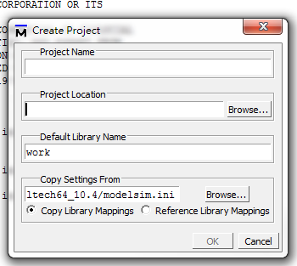
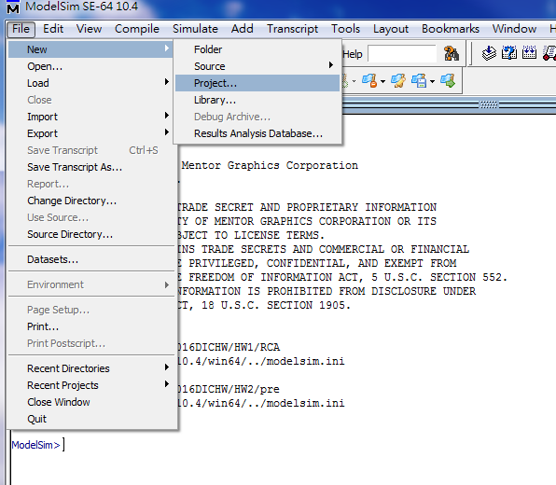
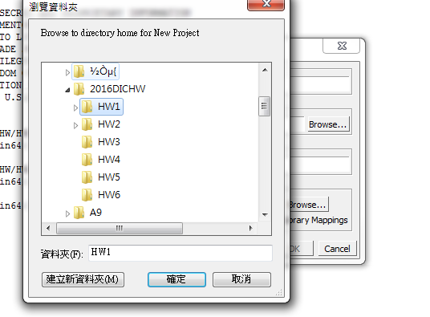
Functional Simulation by ModelSim
Step1: Create a new project
File -> New -> Project
Click “Browse…”
The name of your project
Click here
The file path should be ALL ENGLISH
The location of your project

Slide 5
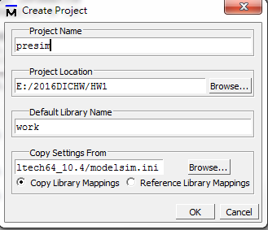
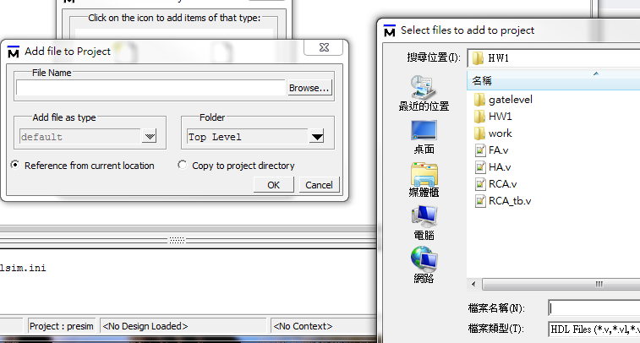
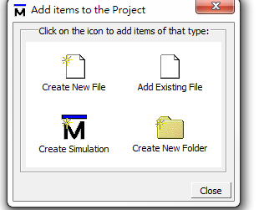
Functional Simulation by ModelSim
Step 2: add the files
Select all the files including the testbench
Click here
Click here
Click here

Slide 6
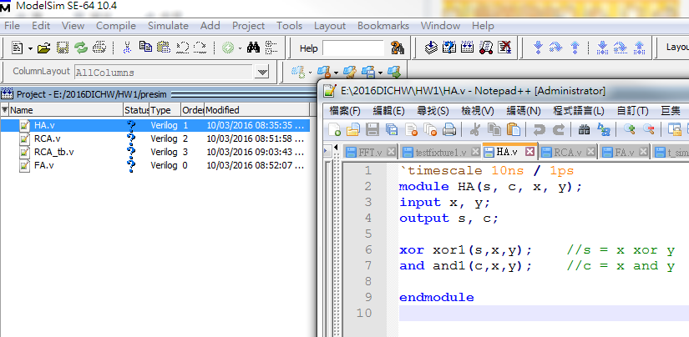
Functional Simulation by ModelSim
Step3 : start coding…

Slide 7
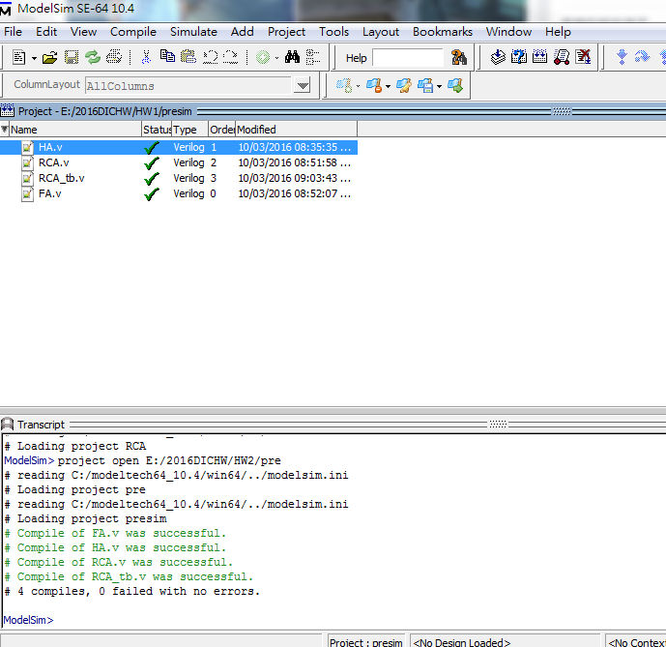
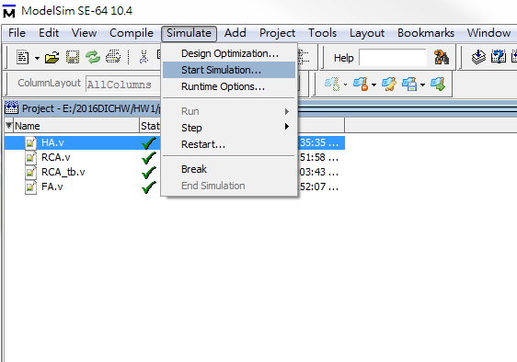
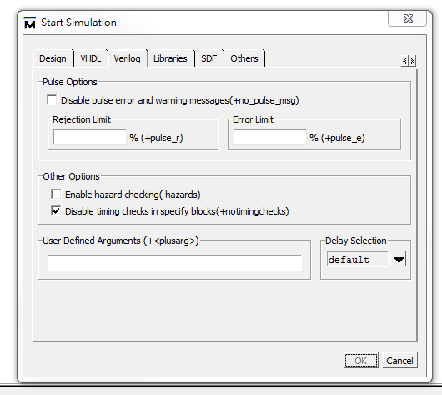
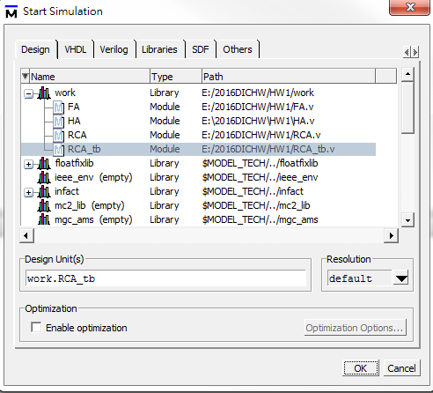
Functional Simulation by ModelSim
Step4: simulation
Compile -> Simulate -> Start Simulation->work->tb
Click here

Slide 8
Functional Simulation by ModelSim
Step4: simulation
Check notiming checks

Slide 9
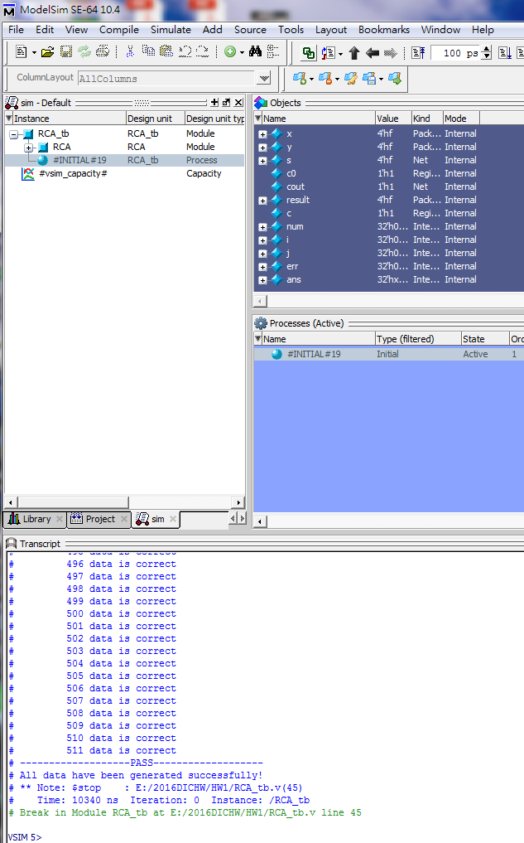
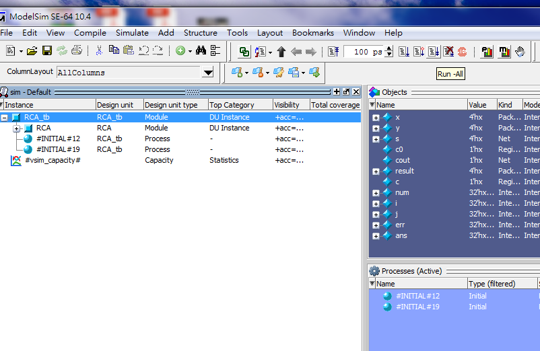
Functional Simulation by ModelSim
Step 4 : simulation
Click here

Slide 10
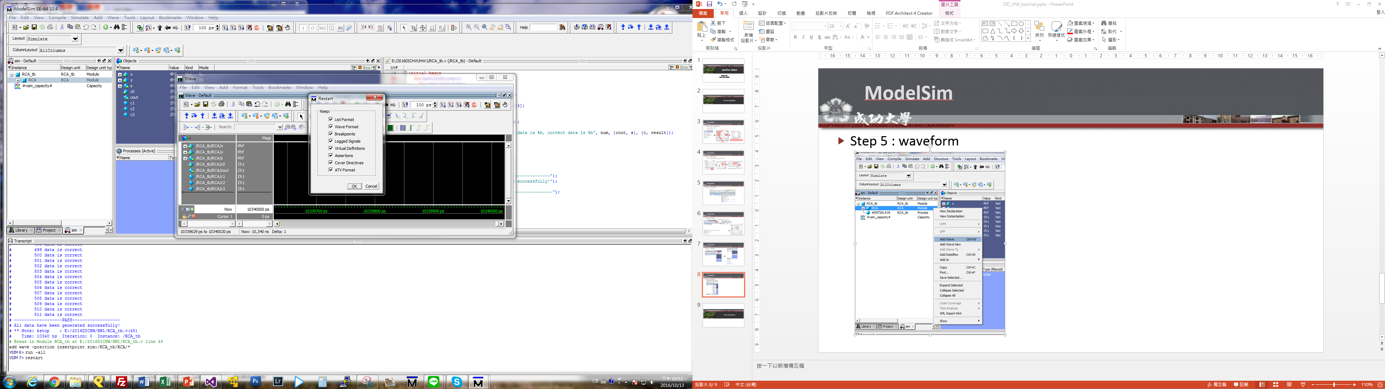
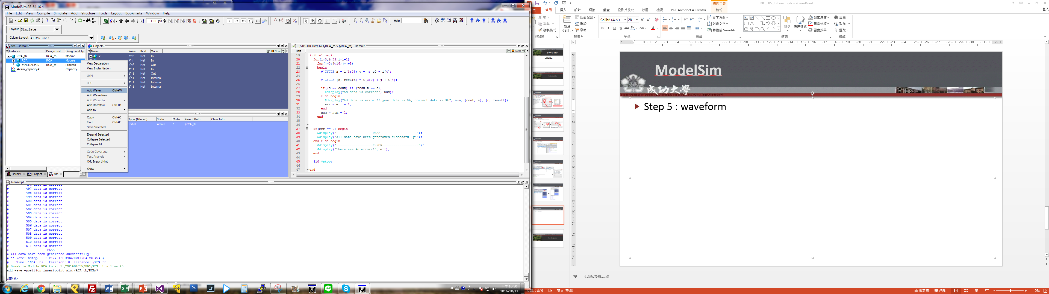
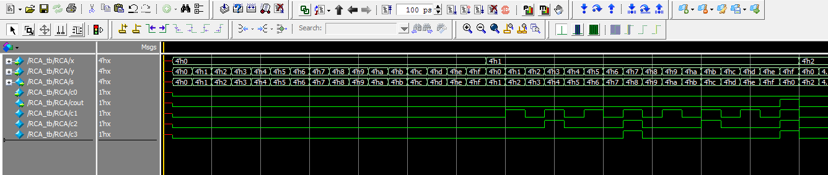
Functional Simulation by ModelSim
You have to “restart” before a new simulation
Step 5 : waveform
Click here

Slide 11
Synthesis by Quartus10.0

Slide 12
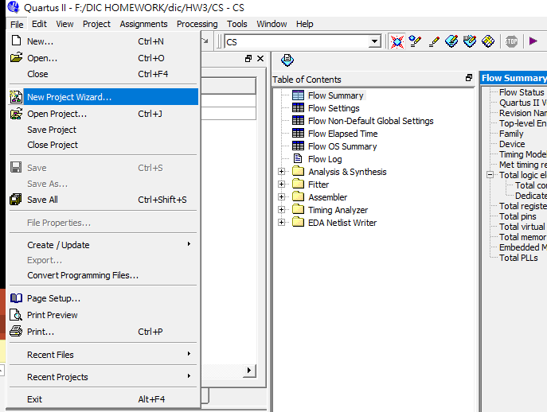
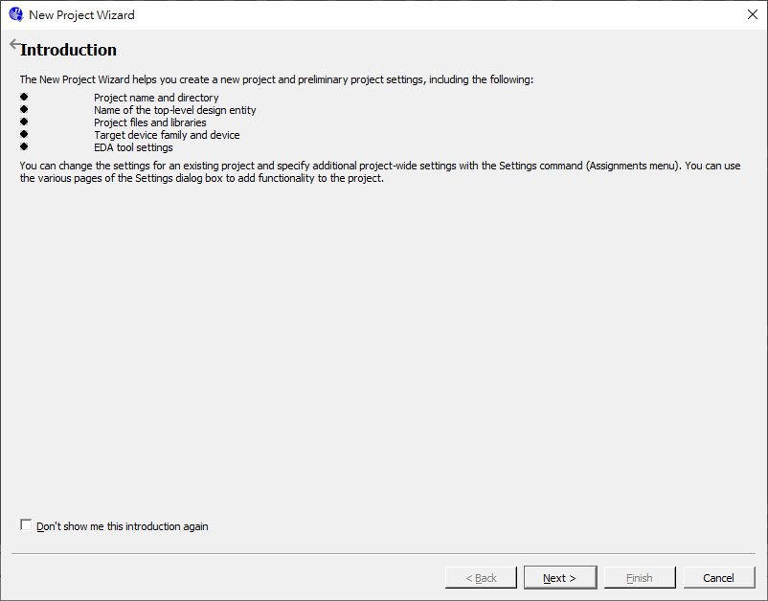
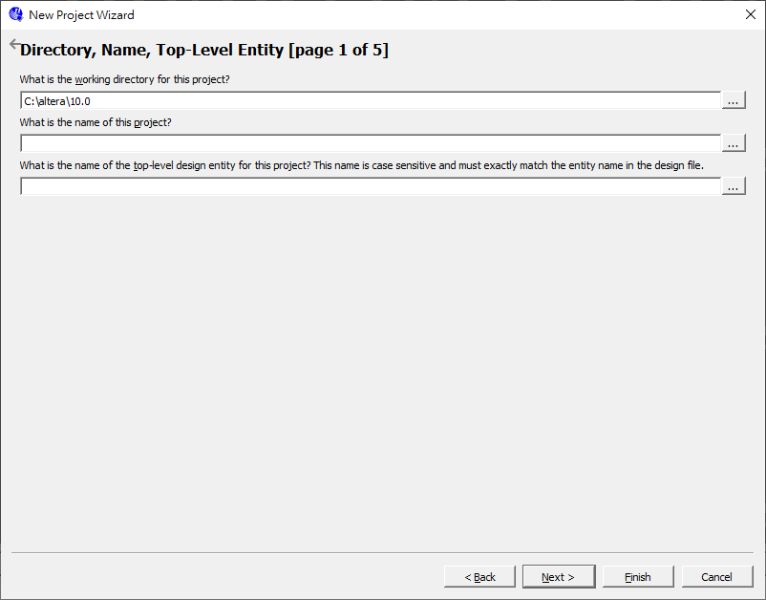
Synthesis by Quartus
Step1: Create a new project
File -> new project wizard
The project path
The project name should be
as same as the name of top module
Click here

Slide 13
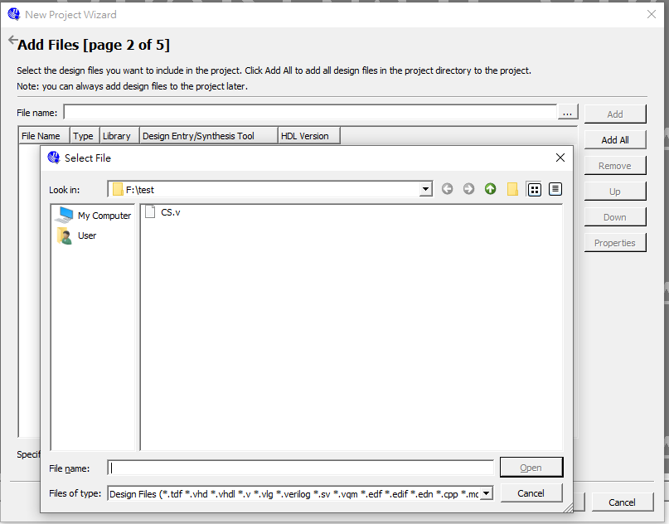
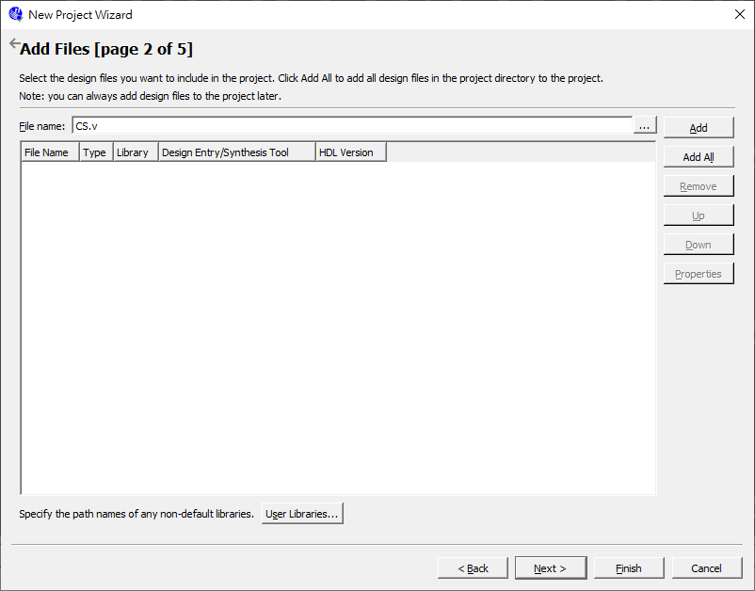
Synthesis by Quartus
Step1: Create a new project
Add the file excepting the testbench
Click here
Click here

Slide 14
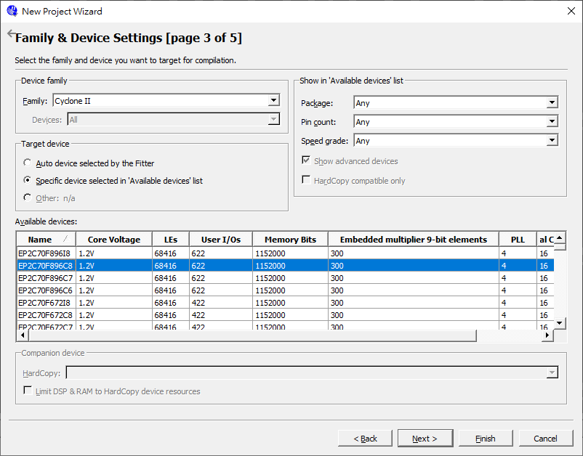
Synthesis by Quartus
Step2: Select the device : Cyclone II EP2C70F896C8

Slide 15
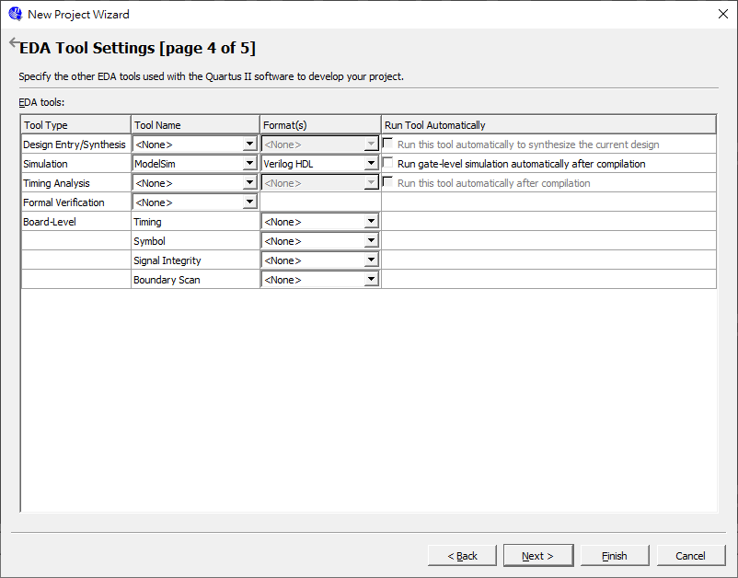
Synthesis by Quartus
Step 3 : Gate level simulation configuration
select ModelSim and Verilog HDL

Slide 16
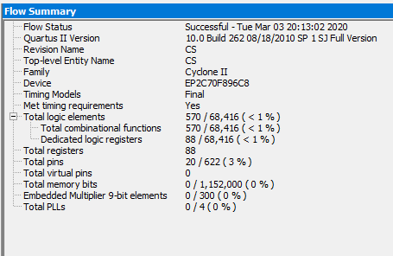
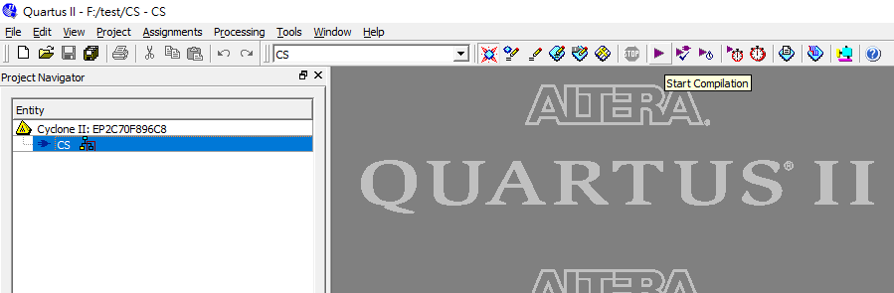
Synthesis by Quartus
Step 4 : compile and you will get the flow summary
Click here

Slide 17
Gate-Level Simulation by ModelSim

Slide 18
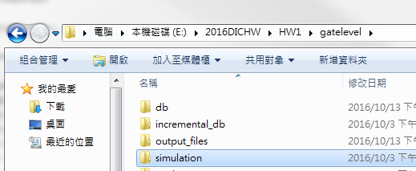
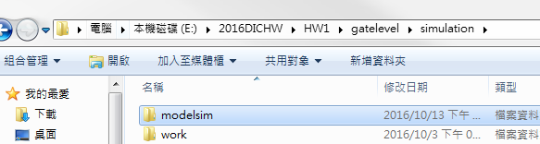
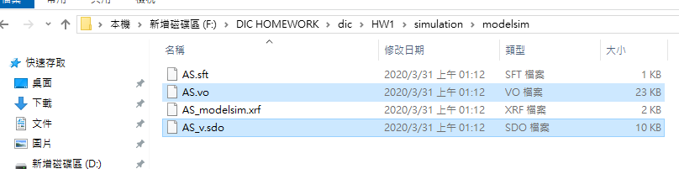
Gate-Level Simulation by ModelSim
Step 1 : the gate level file (*.vo,*.sdo) can be found in simulation/modelsim folder, and put them into modelsim project path.

Slide 19
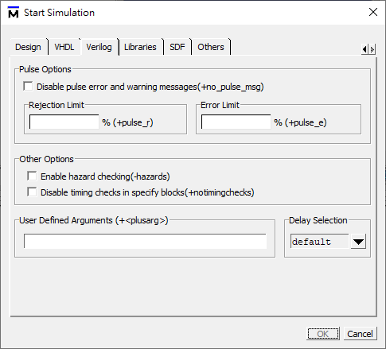
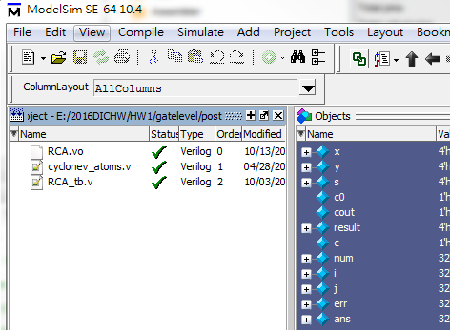
Gate-Level Simulation by ModelSim
Step 2 : gate level simulation
Repeat the steps in pre-sim. Need to cancel the notimingchecks.
This time, use the *.vo and cyclonev_atoms.v for simulation

